Slide 1
Intro to Neural Nets
Week 2: Mathematical Building Blocks & Working with Keras API

Slide 2
Today’s Agenda
1. Building Blocks of NNs
Tensors (and relevant mathematical operations)
Activation Functions
Loss Functions
Backpropagation: Derivatives, Gradients & the Chain Rule (with examples)
Optimizers
2. Building a Linear Classifier
Overview of Keras and Tensorflow.
Implementing a linear classifier in Keras (now that we know the components).

Slide 3

TPUs

Slide 4
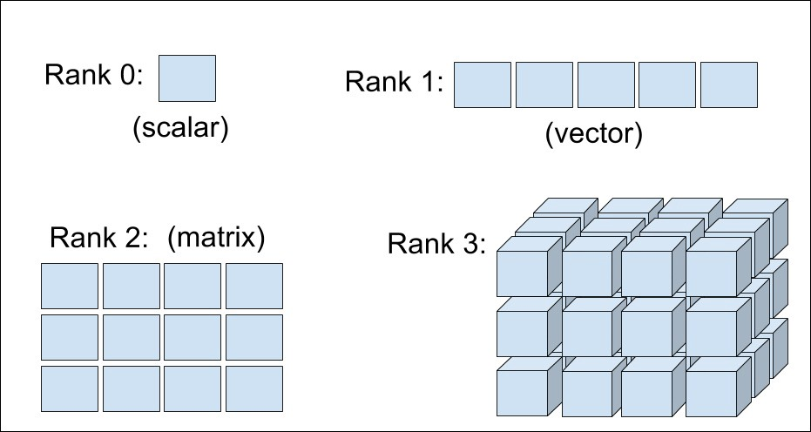
Tensors
Question: What sort of data (give an example) would be stored in a rank-3 tensor? How about a rank-4 tensor?

Slide 5
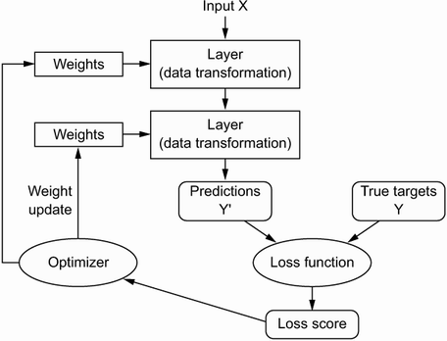
Forward Pass

Slide 6
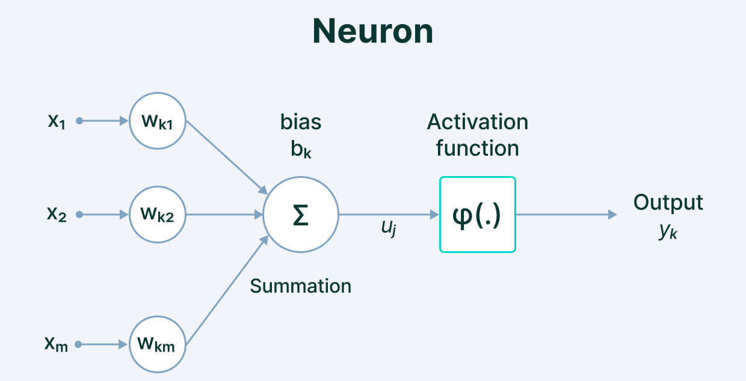
Neuron / Network Components
Question: Which of these values are constants? Which are trainable parameters?
Notes:
We define the network structure (layers / nodes / edges) and the activate functions (within each node). Our data, X and Y (inputs and labels) are given. Our goal is then to “learn” the remaining parameters, i.e., the w’s and b’s.

Slide 7
Neuron / Network Components
Question: What rank tensor are x, w and b here?
What will the shape of y be?
What is the order of operations in a forward pass?

Slide 8
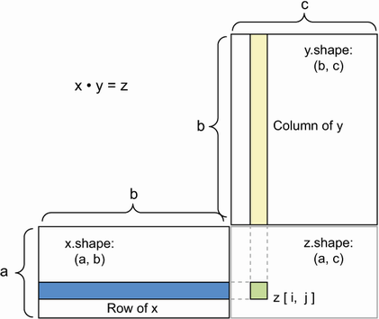
Multiplication
$$y_{1}=φ (x_{1}∙w_{1}+b_{1})$$
Conformity of Shapes
NCOL(X) == NROW(W)
Elements of Resulting Tensor are the Dot Product of X’s Rows and Y’s Columns
Z[2,2] = X[2,:] · Y[:,2]
We Use This for Multiplication Step
x*w calculations.

Slide 9
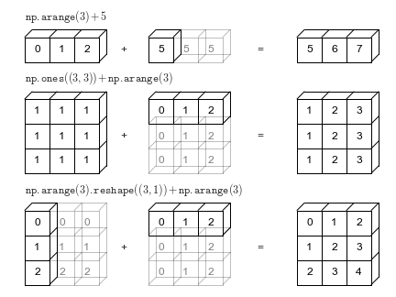
Matrix Addition (Broadcast)
$$y_{1}=φ (x_{1}∙w_{1}+b_{1})$$
Shape of the Two Tensors Needs to Conform
A + B will only work if A is cleanly divisible by B (or vice versa)
Sum Element-wise
Replicate B until it matches A’s dimensions, then perform element-wise addition.
We Use This for the Addition Step
Add x*w and b (bias)
Notes:
General advice – always check the shape of output when writing things from scratch.

Slide 10
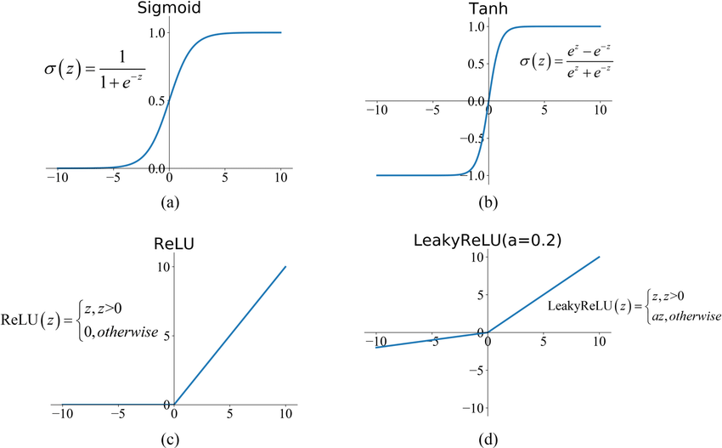
Activation Functions
$$y_{1}=φ (x_{1}∙w_{1}+b_{1})$$
Notes:
The final step in the calculation at each neuron is applying an activation function. These are implemented elementwise to a matrix (representing a layer in the network). A single layer will generally use a common activation function.
When people first started out, they used step functions, e.g., pass a 1 if the x*w+b surpasses a threshold, like 0, else return 0. This resulted in a very unstable network. Small changes in the inputs could have massive effects on the output. This makes the ‘learning’ (optimization) very difficult.
Accordingly, we saw introduction of the sigmoid function, which still nicely bounds output between 0 and 1, but is smooth in its transition, and where the outputs are loosely interpretable as probabilities for binary outcomes taking on a value of 1. However, sigmoid also has problems; it has trouble ‘learning’ when the affine transformations get too positive or negative, because the gradient goes to 0, resulting in what’s known as the vanishing gradient problem, and its output values are strictly non-negative, which means gradients are always strictly positive or strictly negative with respect to inputs (again, presents challenges for the optimization process.
Tanh addresses the issue of gradients being of common sign, by centering the distribution around 0 (outputs range from -1 to 1), but it still has the issue of vanishing gradients for values of large magnitude.
ReLU doesn’t suffer from the vanishing gradient problem if values are positive, though it doesn’t enable any sort of learning if outputs are negative. Leaky ReLU addresses this by allowing some gradient for negative values.
A final, common activation function not shown here is Softmax, which is a multinomial generalization of sigmoid (think multinomial logistic vs. logistic regression). Softmax activation will output multiple positive values between 0 and 1, loosely interpretable as multi-category probabilities. We can’t draw this one because it’s high-dimensional in the output (not unidimensional).

Slide 11
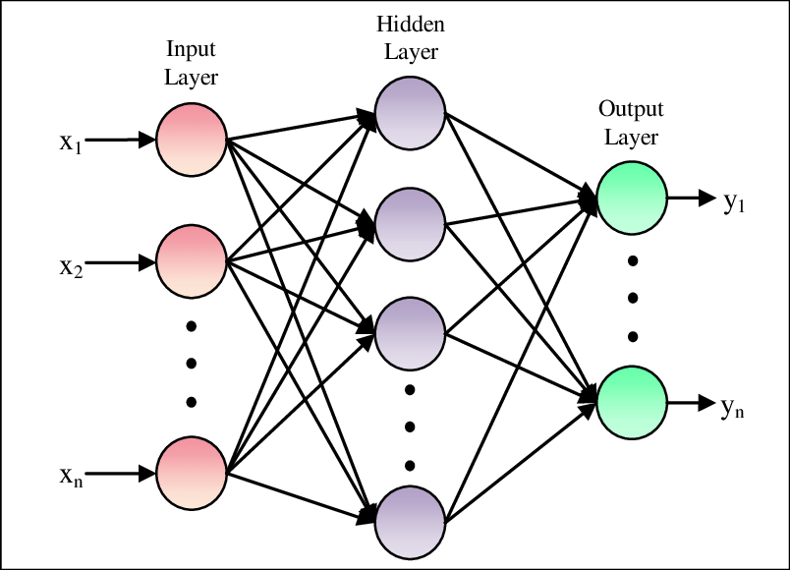


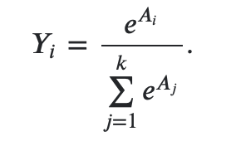
Multi-Class, Single-Label
$$y_{1}=φ (x_{1}∙w_{1}+b_{1})$$
Softmax (MLOGIT):
We have D inputs (x’s).
We have k outputs (classes).
So, W is a (D,k) matrix and X is a (D,1) matrix.
That means, A is a (k,1) matrix.
That means Y is also a (k,1) matrix.
D
k
Notes:
The final step in the calculation at each neuron is applying an activation function. These are implemented elementwise to a matrix (representing a layer in the network). A single layer will generally use a common activation function.
When people first started out, they used step functions, e.g., pass a 1 if the x*w+b surpasses a threshold, like 0, else return 0. This resulted in a very unstable network. Small changes in the inputs could have massive effects on the output. This makes the ‘learning’ (optimization) very difficult.
Accordingly, we saw introduction of the sigmoid function, which still nicely bounds output between 0 and 1, but is smooth in its transition, and where the outputs are loosely interpretable as probabilities for binary outcomes taking on a value of 1. However, sigmoid also has problems; it has trouble ‘learning’ when the affine transformations get too positive or negative, because the gradient goes to 0, resulting in what’s known as the vanishing gradient problem, and its output values are strictly non-negative, which means gradients are always strictly positive or strictly negative with respect to inputs (again, presents challenges for the optimization process.
Tanh addresses the issue of gradients being of common sign, by centering the distribution around 0 (outputs range from -1 to 1), but it still has the issue of vanishing gradients for values of large magnitude.
ReLU doesn’t suffer from the vanishing gradient problem if values are positive, though it doesn’t enable any sort of learning if outputs are negative. Leaky ReLU addresses this by allowing some gradient for negative values.
A final, common activation function not shown here is Softmax, which is a multinomial generalization of sigmoid (think multinomial logistic vs. logistic regression). Softmax activation will output multiple positive values between 0 and 1, loosely interpretable as multi-category probabilities. We can’t draw this one because it’s high-dimensional in the output (not unidimensional).

Slide 12
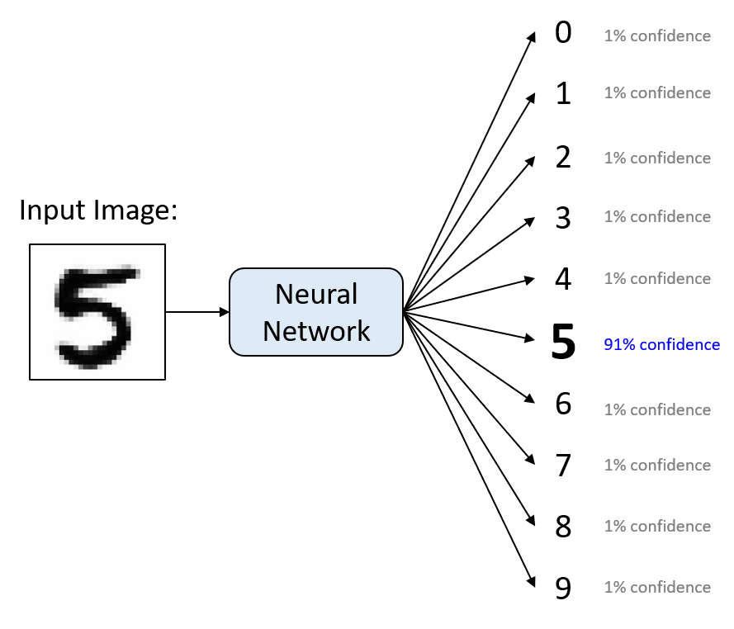
Multi-Class, Single-Label
$$y_{1}=φ (x_{1}∙w_{1}+b_{1})$$
Notes:
The final step in the calculation at each neuron is applying an activation function. These are implemented elementwise to a matrix (representing a layer in the network). A single layer will generally use a common activation function.
When people first started out, they used step functions, e.g., pass a 1 if the x*w+b surpasses a threshold, like 0, else return 0. This resulted in a very unstable network. Small changes in the inputs could have massive effects on the output. This makes the ‘learning’ (optimization) very difficult.
Accordingly, we saw introduction of the sigmoid function, which still nicely bounds output between 0 and 1, but is smooth in its transition, and where the outputs are loosely interpretable as probabilities for binary outcomes taking on a value of 1. However, sigmoid also has problems; it has trouble ‘learning’ when the affine transformations get too positive or negative, because the gradient goes to 0, resulting in what’s known as the vanishing gradient problem, and its output values are strictly non-negative, which means gradients are always strictly positive or strictly negative with respect to inputs (again, presents challenges for the optimization process.
Tanh addresses the issue of gradients being of common sign, by centering the distribution around 0 (outputs range from -1 to 1), but it still has the issue of vanishing gradients for values of large magnitude.
ReLU doesn’t suffer from the vanishing gradient problem if values are positive, though it doesn’t enable any sort of learning if outputs are negative. Leaky ReLU addresses this by allowing some gradient for negative values.
A final, common activation function not shown here is Softmax, which is a multinomial generalization of sigmoid (think multinomial logistic vs. logistic regression). Softmax activation will output multiple positive values between 0 and 1, loosely interpretable as multi-category probabilities. We can’t draw this one because it’s high-dimensional in the output (not unidimensional).

Slide 13
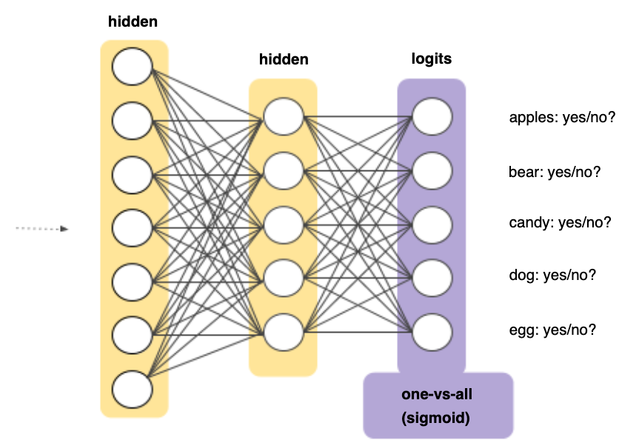
Multi-Class, Multi-Label
Many Non-Exclusive Labels
We would create a sigmoid output layer with one output for each class we are predicting.
Train on all labels together.
Notes:
The final step in the calculation at each neuron is applying an activation function. These are implemented elementwise to a matrix (representing a layer in the network). A single layer will generally use a common activation function.
When people first started out, they used step functions, e.g., pass a 1 if the x*w+b surpasses a threshold, like 0, else return 0. This resulted in a very unstable network. Small changes in the inputs could have massive effects on the output. This makes the ‘learning’ (optimization) very difficult.
Accordingly, we saw introduction of the sigmoid function, which still nicely bounds output between 0 and 1, but is smooth in its transition, and where the outputs are loosely interpretable as probabilities for binary outcomes taking on a value of 1. However, sigmoid also has problems; it has trouble ‘learning’ when the affine transformations get too positive or negative, because the gradient goes to 0, resulting in what’s known as the vanishing gradient problem, and its output values are strictly non-negative, which means gradients are always strictly positive or strictly negative with respect to inputs (again, presents challenges for the optimization process.
Tanh addresses the issue of gradients being of common sign, by centering the distribution around 0 (outputs range from -1 to 1), but it still has the issue of vanishing gradients for values of large magnitude.
ReLU doesn’t suffer from the vanishing gradient problem if values are positive, though it doesn’t enable any sort of learning if outputs are negative. Leaky ReLU addresses this by allowing some gradient for negative values.
A final, common activation function not shown here is Softmax, which is a multinomial generalization of sigmoid (think multinomial logistic vs. logistic regression). Softmax activation will output multiple positive values between 0 and 1, loosely interpretable as multi-category probabilities. We can’t draw this one because it’s high-dimensional in the output (not unidimensional).

Slide 14




We Know Enough for a Forward Pass
Calculate Output of Each Node Sequentially
$$W,b_{1}$$
$$y_{1}$$
$$x_{1}$$
$$y_{1}=φ (x_{1}∙w_{1,1}+x_{2}∙w_{1,2}+…+b_{1})$$
$$y_{2}=φ \left(x_{1}∙w_{2,1}+x_{2}∙w_{2,2}+…+b_{2}\right)$$
$$…$$
Eventually We Obtain Model’s Predictions
Notes:
Note, for initial forward pass, we initialize w’s and b’s to small random values (not zero – if we set them all to the same value, e.g., zero, the optimization will fail, because small changes to parameters will have the same effect on the loss for every parameter, meaning the optimizer will update all of the parameters identically, and the optimizer will get stuck).

Slide 15
Calculate Loss
Notes:
How do we implement the learning (optimization)? Gradient descent. We identify where we are on the loss curve, figure out a first derivative along all available dimensions (i.e., along all parameters), and proceed where the gradient is most negative (i.e., where the loss function progresses most rapidly toward zero. For this to work, we need to be able to figure out the gradient along each dimension (for each parameter) in a computationally efficient way (remember, some of the biggest models have thousands or millions of parameters!).

Slide 16
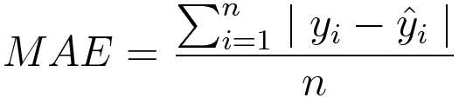

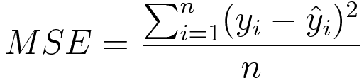

Loss Functions
MAE / L1 Loss
Typical for continuous outcomes. Errors are penalized homogenously, in magnitude and direction. This should look familiar!
Cross-Entropy / Log-Loss
Typical for binary outcomes. Value grows exponentially larger as the predicted probability moves away from the true 0,1 label.
Multi-category outcomes have an analogous loss function known as categorical cross-entropy.
MSE / Quadratic / L2 Loss
Typical for continuous outcomes, larger errors penalized exponentially more. This should look familiar!
Notes:
Note, for initial forward pass, we initialize w’s and b’s to small random values (not zero – if we set them all to the same value, e.g., zero, the optimization will fail, because small changes to parameters will have the same effect on the loss for every parameter, meaning the optimizer will update all of the parameters identically, and the optimizer will get stuck).

Slide 17
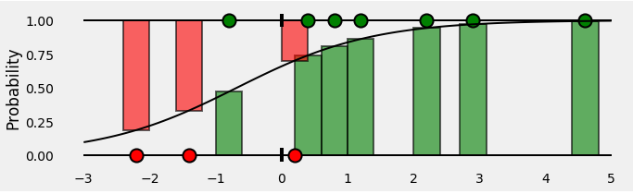
Binary Cross-Entropy Loss
Piecemeal Function:
If ground truth is 1, then loss is -1*log(p). As prediction approaches 1, loss approaches 0. As prediction approaches 0, loss grows exponentially.
If ground truth is 0, then loss is -1*log(1-p). As prediction approaches 1, loss rises exponentially. As prediction approaches 0, loss approaches 0.

Slide 18
Backpropagation
Notes:
Now for the magic, where we propagate performance backward through the network to update our weight and bias parameters. The goal here is to figure how how we should bump all the parameters (and in what direction), to reduce the error (loss).

Slide 19
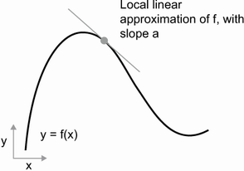
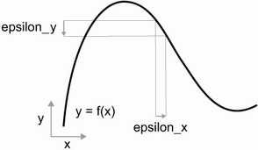
Derivative = “Rate” of Change
Notes:
We want to know how our loss function output will change for small increases in every parameter value. This is what a derivative tells us. For a small change in x from its current value (e.g., w_1+0.001), how will the value of y change relative to its current value (e.g., how will the loss value shift)?

Slide 20
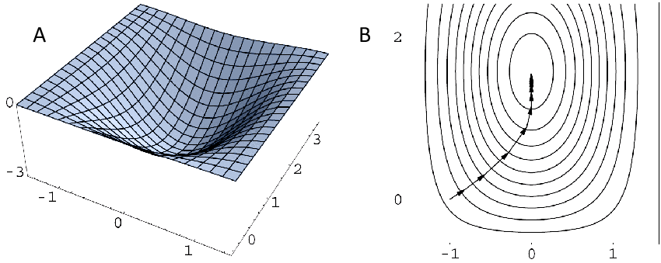
Gradient = Derivative in Multiple Dimensions
Notes:
A gradient is just a higher dimensional derivative (e.g., we figure out derivative of y with respect to its two inputs, the gradient is the derivative in that two-dimensional space. We would want to find the direction in that two-dimensional space where the gradient is steepest (most positive) and then go in the opposite direction.

Slide 21
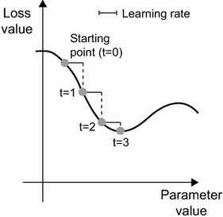
Gradient Descent
Notes:
A gradient is just a higher dimensional derivative (e.g., we figure out derivative of y with respect to its two inputs, the gradient is the derivative in that two-dimensional space. We would want to find the direction in that two-dimensional space where the gradient is steepest (most positive) and then go in the opposite direction.

Slide 22
Derivatives of Loss w.r.t All Parameters
Recall that Each Node’s Output Can be Expressed as a Function of the Prior Nodes’ Outputs
Start at the final nodes in the network and work backwards
We calculate partial derivatives w.r.t. their inputs / weights.
Then, use those partial derivatives and work backward into earlier layers to get partial derivatives w.r.t. their inputs / weights, and so on.
$$y_{1}=φ (x_{1}∙w_{1,1}+x_{2}∙w_{1,2}+…+b_{1})$$
$$y_{2}=φ \left(x_{1}∙w_{2,1}+x_{2}∙w_{2,2}+…+b_{2}\right)$$
$$…$$

Slide 23







Simplifying Gradients: Computation Graph
$$J=3(a∙b+c)$$
$$a=6$$
$$u=a∙b$$
$$z=u+c$$
$$J=3(z)$$
$$b=4$$
$$c=2$$
Notes:
Computation graphs are implemented in TensorFlow using ‘Tape’

Slide 24
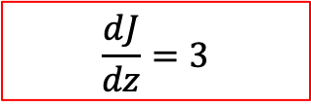
Backpropagation = Working Backwards
$$J=3(a∙b+c)$$
$$a=6$$
$$u=a∙b$$
$$z=u+c$$
$$J=3(z)$$
$$b=4$$
$$\frac{ⅆJ}{dz}=3$$
$$c=2$$
Notes:
Computation graphs are implemented in TensorFlow using ‘Tape’

Slide 25
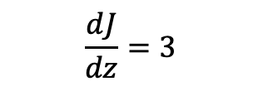
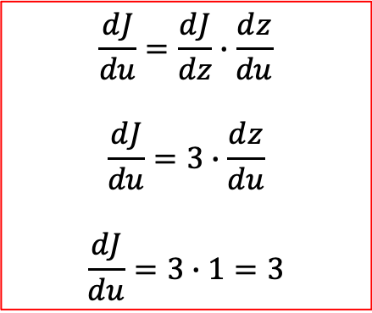
Backpropagation = Work Backwards
$$\frac{ⅆJ}{dz}=3$$
$$J=3(a∙b+c)$$
$$a=6$$
$$u=a∙b$$
$$z=u+c$$
$$J=3(z)$$
$$b=4$$
$$\frac{ⅆJ}{du}=\frac{ⅆJ}{dz}∙\frac{ⅆz}{du}$$
$$\frac{ⅆJ}{du}=3∙\frac{ⅆz}{du}$$
$$\frac{ⅆJ}{du}=3∙1=3$$
$$c=2$$
Notes:
Computation graphs are implemented in TensorFlow using ‘Tape’

Slide 26
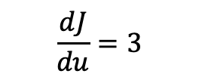
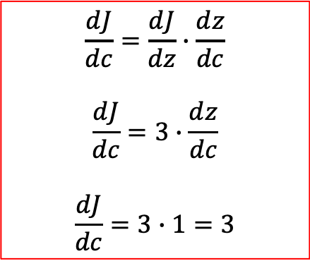
Backpropagation = Work Backwards
$$\frac{ⅆJ}{dz}=3$$
$$\frac{ⅆJ}{du}=3$$
$$J=3(a∙b+c)$$
$$a=6$$
$$u=a∙b$$
$$z=u+c$$
$$J=3(z)$$
$$b=4$$
$$\frac{ⅆJ}{dc}=\frac{ⅆJ}{dz}∙\frac{ⅆz}{dc}$$
$$\frac{ⅆJ}{dc}=3∙\frac{ⅆz}{dc}$$
$$\frac{ⅆJ}{dc}=3∙1=3$$
$$c=2$$
Notes:
Computation graphs are implemented in TensorFlow using ‘Tape’

Slide 27
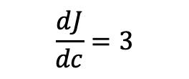
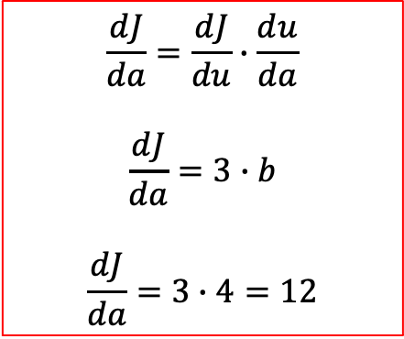
Backpropagation = Work Backwards
$$\frac{ⅆJ}{dz}=3$$
$$\frac{ⅆJ}{du}=3$$
$$J=3(a∙b+c)$$
$$\frac{ⅆJ}{dc}=3$$
$$a=6$$
$$u=a∙b$$
$$z=u+c$$
$$J=3(z)$$
$$b=4$$
$$\frac{ⅆJ}{da}=\frac{ⅆJ}{du}∙\frac{ⅆu}{da}$$
$$\frac{ⅆJ}{da}=3∙b$$
$$\frac{ⅆJ}{da}=3∙4=12$$
$$c=2$$
Notes:
Computation graphs are implemented in TensorFlow using ‘Tape’

Slide 28

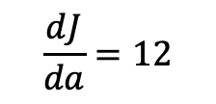
Backpropagation = Work Backwards
$$\frac{ⅆJ}{dz}=3$$
$$\frac{ⅆJ}{du}=3$$
$$J=3(a∙b+c)$$
$$\frac{ⅆJ}{da}=12$$
$$\frac{ⅆJ}{dc}=3$$
$$a=6$$
$$u=a∙b$$
$$z=u+c$$
$$J=3(z)$$
$$b=4$$
$$\frac{ⅆJ}{db}=\frac{ⅆJ}{du}∙\frac{ⅆu}{db}$$
$$\frac{ⅆJ}{db}=3∙a$$
$$\frac{ⅆJ}{da}=3∙6=18$$
We thus update our parameters, a, b, and c, subtracting each’s gradients*epsilon from its current value. Epsilon is the learning rate.
$$c=2$$
Notes:
Computation graphs are implemented in TensorFlow using ‘Tape’

Slide 29

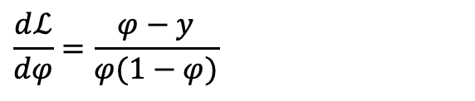


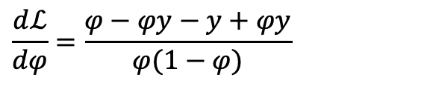

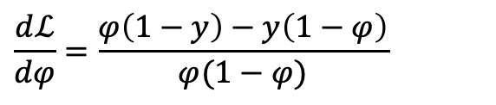

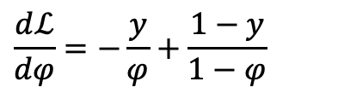


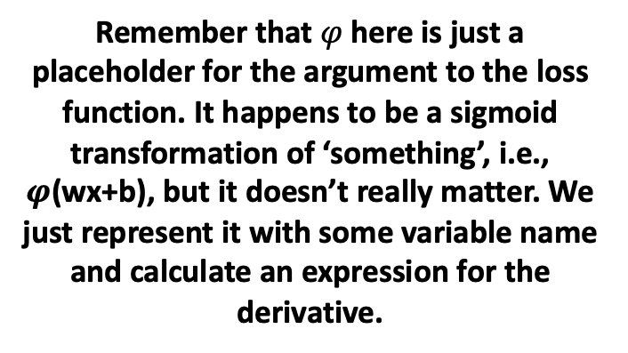
Single Node with Sigmoid & Cross-Entropy Loss (i.e., Logistic Regression)
$$x_{1}=2$$
$$w_{1}$$
$$b$$
$$\frac{ⅆℒ}{dφ}=−\frac{y}{φ}+\frac{1−y}{1−φ}$$
$φ$()
$$ℒ\left(y,\hat{y}\right)$$
$$\frac{ⅆℒ}{dφ}=\frac{φ\left(1−y\right)−y\left(1−φ\right)}{φ(1−φ)}$$
$$w_{2}$$
$$x_{2}=3$$
Remember that $φ$here is just a placeholder for the argument to the loss function. It happens to be a sigmoid transformation of ‘something’, i.e., $φ\text{(}\text{wx}\text{+}\text{b}\text{)}$, but it doesn’t really matter. We just represent it with some variable name and calculate an expression for the derivative.
$$\frac{ⅆℒ}{dφ}=\frac{φ−φy−y+φy}{φ(1−φ)}$$
$$\frac{ⅆℒ}{dφ}=\frac{φ−y}{φ(1−φ)}$$
Notes:
Loss function here is binary cross-entropy loss. Can prove that the derivative of cross entropy loss function with respect to prediction is what I have written here.

Slide 30
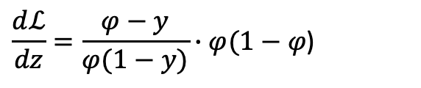
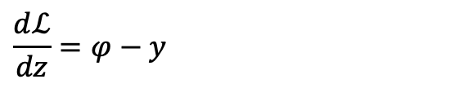
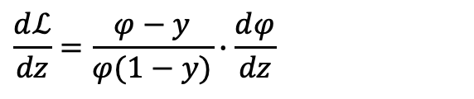

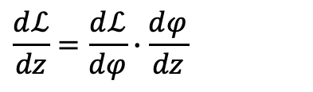
Single Node with Sigmoid & Cross-Entropy Loss (i.e., Logistic Regression)
$$x_{1}=2$$
$$w_{1}$$
$$b$$
$$\frac{ⅆℒ}{dz}=\frac{ⅆℒ}{dφ}∙\frac{ⅆφ}{dz}$$
$φ$()
$$ℒ\left(y,\hat{y}\right)$$
$$\frac{ⅆℒ}{dz}=\frac{φ−y}{φ(1−y)}∙\frac{ⅆφ}{dz}$$
$$w_{2}$$
$$x_{2}=3$$
Now we calculate derivative of the sigmoid with respect to its argument, z.
$$\frac{ⅆℒ}{dz}=\frac{φ−y}{φ(1−y)}∙φ(1−φ\text{)}$$
$$φ\left(z\right)={(1+e^{−z})}^{−1}$$
$$\frac{ⅆℒ}{dz}=φ−y$$
$φ′\left(z\right)={−1∙(1+e^{−z})}^{−2}∙$ $(0+e^{−z}∙−1)$
$φ′\left(z\right)={(1+e^{−z})}^{−2}∙$ $e^{−z}$
$φ′\left(z\right)=φ\left(z\right)∙(1−φ\left(z\right)$)
Notes:
You can rearrange to show the final step in sigmoid derivative…

Slide 31

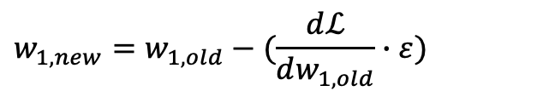

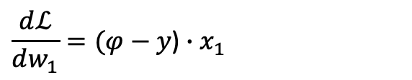

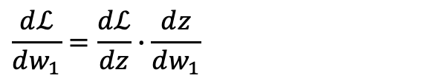

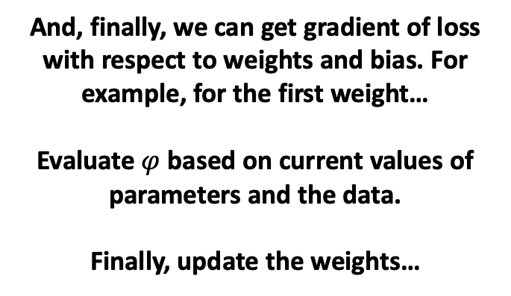
Single Node with Sigmoid & Cross-Entropy Loss (i.e., Logistic Regression)
$$x_{1}=2$$
$$w_{1}=5$$
$b$=1
$φ$()
$$ℒ\left(y=1,\hat{y}\right)$$
$$\frac{ⅆℒ}{dw_{1}}=\frac{ⅆℒ}{dz}∙\frac{ⅆz}{dw_{1}}$$
$$w_{2}=6$$
$$\frac{ⅆℒ}{dw_{1}}=(φ−y\text{)}∙x_{1}$$
$$x_{2}=3$$
And, finally, we can get gradient of loss with respect to weights and bias. For example, for the first weight…
Evaluate $φ$ based on current values of parameters and the data.
Finally, update the weights…
$$w_{1,new}=w_{1,old}−(\frac{ⅆℒ}{dw_{1,old}}∙ε)$$
Notes:
You can rearrange to show the final step in sigmoid derivative…

Slide 32
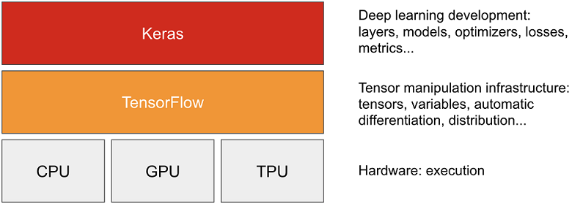
Keras and Tensorflow
1. Tensorflow
A Python platform for working with tensors, implementing automatic differentiation, providing access to repositories of (well-known) pre-trained models.
2. Keras
A higher-level API that wraps common usage patterns with Tensorflow functions, pre-defined loss functions, optimization algorithms, etc.
Keras simplifies data scientists’ interaction with Tensorflow.

Slide 33

Tensorflow GradientTape: AutoDiff
1. Gradient Tape
A Tensorflow function that automates the calculation of derivatives.
It constructs a computation graph in the background and implements codified rules for calculating derivatives of functions.
You could technically use gradient tape to implement a gradient descent algorithm for many optimization problems.

Slide 34
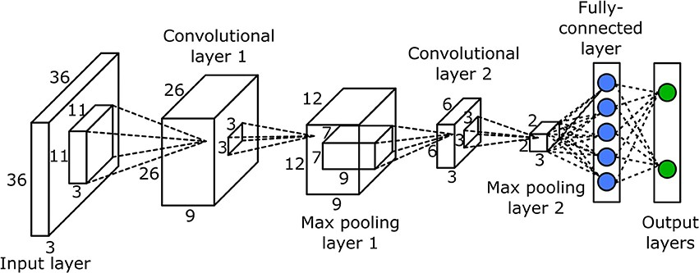
The Layer
Layers are the Key Building Block of NNs in Keras
There are a few subclasses of the Layers class: e.g., Dense is the one we have seen so far – layers.Dense(), but we also have convolutional layers, max-pooling layers, recurrent layers, and so on. There are many pre-defined layers in Keras. See: https://keras.io/api/layers/.
These are different architectural components that can be mixed and matched in different ways to create different network topologies.
It is also possible to construct custom layers.

Slide 35
Sequential vs. Functional API
We Have Only Used Sequential API So Far
Sequential is easy to work with but is also very inflexible. Can only really handle basic feed-forward networks. It automatically figures out the shape of each layer’s output tensor and specifies the next layer’s input shape accordingly.
Functional API Let’s You Construct Any Topology You Want
But – we will look at the difference in how each API is used, syntactically.
Syntactic Simplicity
Architectural Flexibility
Sequential API
Functional API

Slide 36
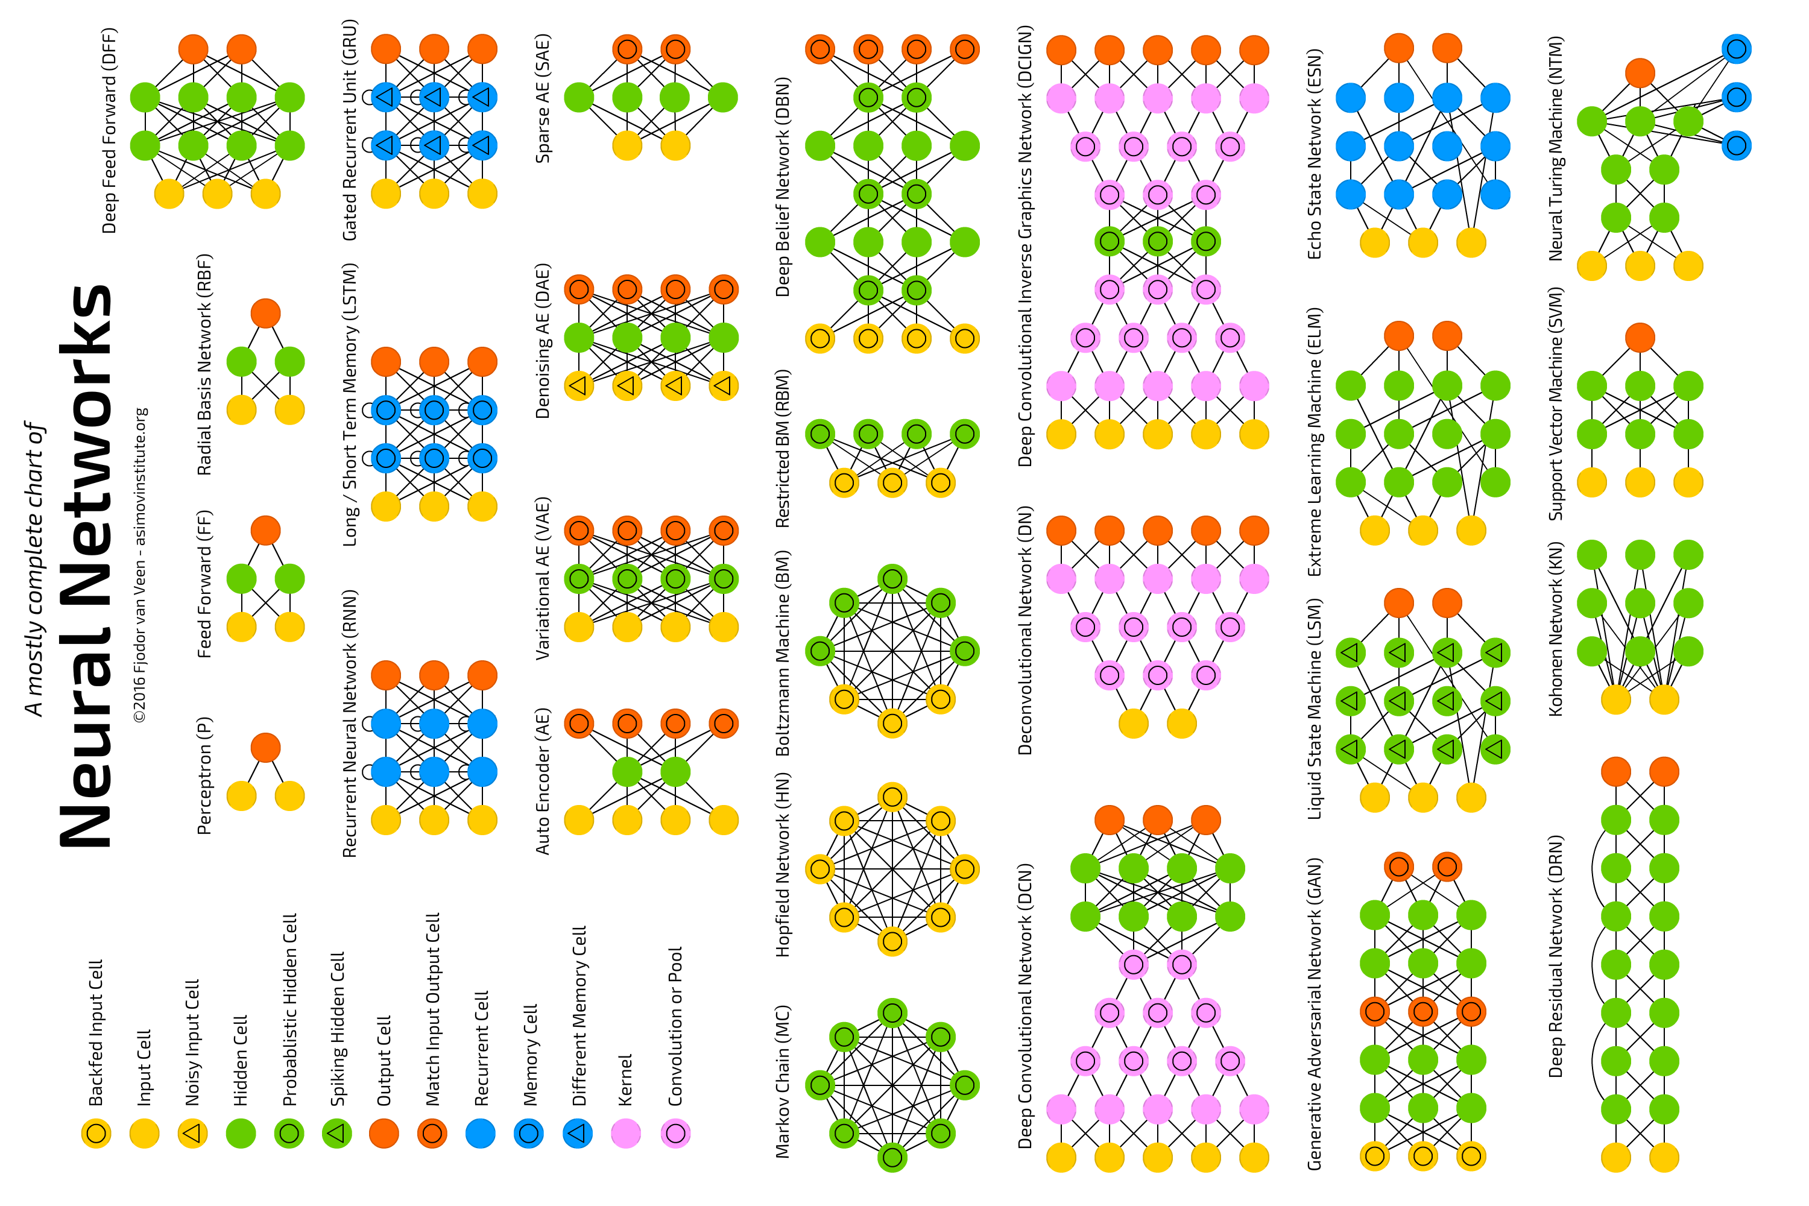

Slide 37
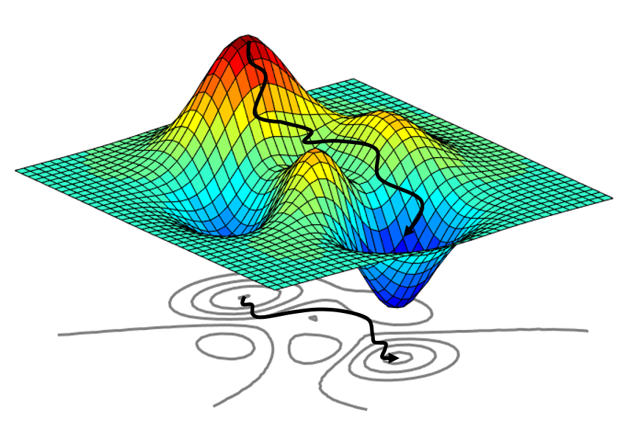
Optimizers
Keras Supports 8 Optimizers
SGD = Stochastic Gradient Descent
Momentum
Ftrl (2010) = Follow the Regularized Leader
Adagrad and Adadelta (2012) = Adaptive Gradient Descent
RMSprop (~2012) = Root Mean Squared propagation
Adam (2015) = Adadelta / RMSProp with Momentum.
Adamax, Nadam are extensions to Adam.

Slide 38
SGD: Gradient Descent
Types of GD
Batch GD = Use all the available training data in each pass.
Works well if the loss surface is smooth and lacks any saddle points / valleys.
Stochastic GD = Mini-batch with batch size = 1.
If troughs / saddles exist, we move past them as our exploration of gradients for the model will vary withe a given observation that we are considering in an iteration.
Computationally quite burdensome but performs well on non-linear problems (eventually).
Mini-batch GD = What we have been doing so far (randomly split the data in each epoch, into folds, and then cycle over the folds for training).
This is a happy-medium between batch and stochastic GD.
Role of Batch Size
Empirically has been observed that smaller batches yield less overfitting (because of implicit noise in the training process – variance of the gradients obtained will go up).

Slide 39
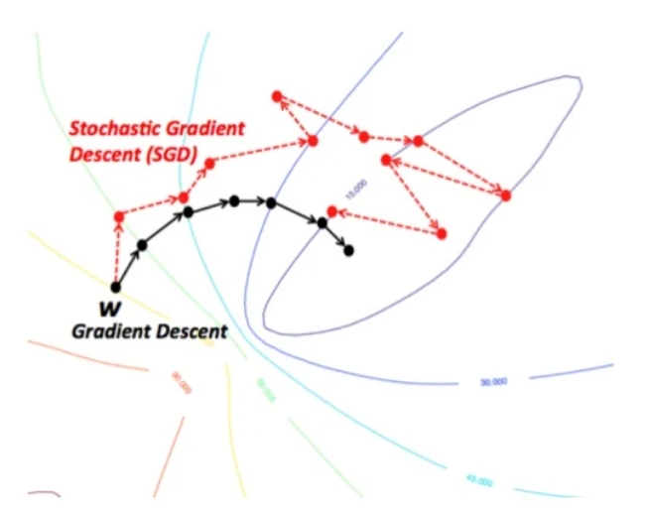
Batch (All) vs. Stochastic (1)
Same Convergence
If you have a convex surface, either approach will converge to the global optimum (no guarantee your problem is convex of course). Always converges at least to a local minimum.
Tradeoffs
Batch, each step is slower, more computationally burdensome, but convergence with fewer iterations; Need to be able to hold the entire dataset in memory.
SGD makes noisier updates, and requires more iterations to converge, but a single iteration is quick. Only need one observation in memory at a time.

Slide 40
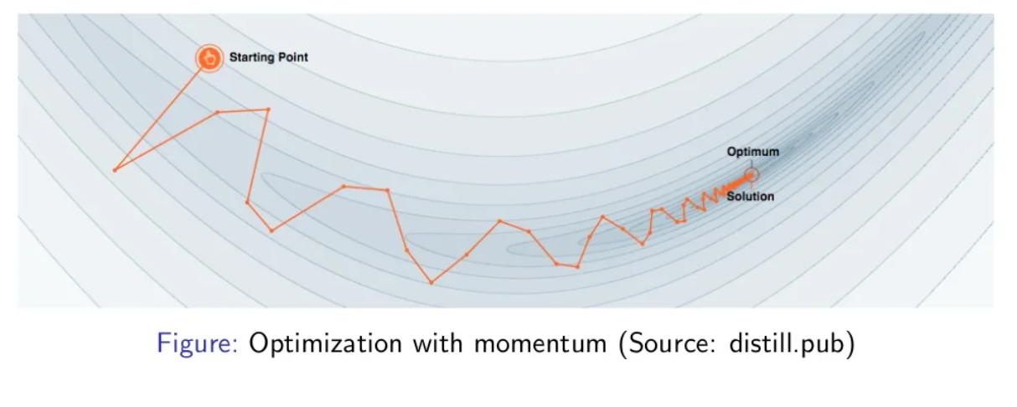
Momentum
Getting Past Local Minima
SGD gets stuck in local minima; the idea of momentum is to make updates be a function of current gradient*learning rate, as well as some fraction (decay) of the update you made last iteration.
This reduces updates to parameters where the gradients are flipping sign and amplifies updates to gradients that are going in a consistent direction (steeply descending).

Slide 41

FTRL
Google Developed in 2010…
This is an optimization technique that is used in “online” learning; it’s typically used in situations where your model training is happening continuously as new data arrives, and where drift might therefore happen.
It works well in situations where you have a ton of sparse features.
Was originally used for predicting conversion in online advertising systems.

Slide 42
Adagrad & Adadelta (RMS Prop)
Adaptive Gradient Descent (Variable Learning Rate)
We implicitly apply a high learning rate for features we have been updating very little so far (speed up movement through saddle points, for example).
We implicitly apply a low learning rate for features we have been updating a lot so far.
Technically learning rate is removed from the process, every update is a function of past updates.
Adadelta
Same idea but we use a sliding window of previous updates to determine magnitude of current updates (rather than all prior updates).
RMSProp is conceptually very similar but was independently developed (around the same time).

Slide 43
Recap
Building Blocks of NNs
Tensors and Tensor Operations
Activation Functions
Loss Functions
Backpropagation: Derivatives, Gradients & the Chain Rule
Procedure of Minibatch Stochastic Gradient Descent
Grab a batch of observations (samples)
Predict their labels using current weights / bias terms.
Calculate loss value.
Calculate gradient of loss w.r.t. all weight / bias terms.
Update each weight by subtracting its gradient*learning rate
Cycle over the whole training dataset (each cycle is an epoch) repeatedly, until loss is small.
Notes:
Note that I don’t expect you to implement a neural network from scratch. This is just to give you an understanding of how they work.

